Slide 1
3D Model Structural Viability Assistant
Gabriel Donnan

Slide 2

Agenda
Rationale
State of the Art
Methods + Results
Future Plans
Questions

Slide 3

Rationale
Project Goal:
Create a software extension to the 3D modelling software, Blender which allows for material and balance analysis of how objects would behave in real life.
Why?:
- Blender does not currently have a method of model analysis, despite a normally rich feature suite.
- This tool would mean anyone can see how their model would behave free of charge without need for AutoCAD experience
- Current options for such a software only exist in the price range of £5000+ per annum.

Slide 4
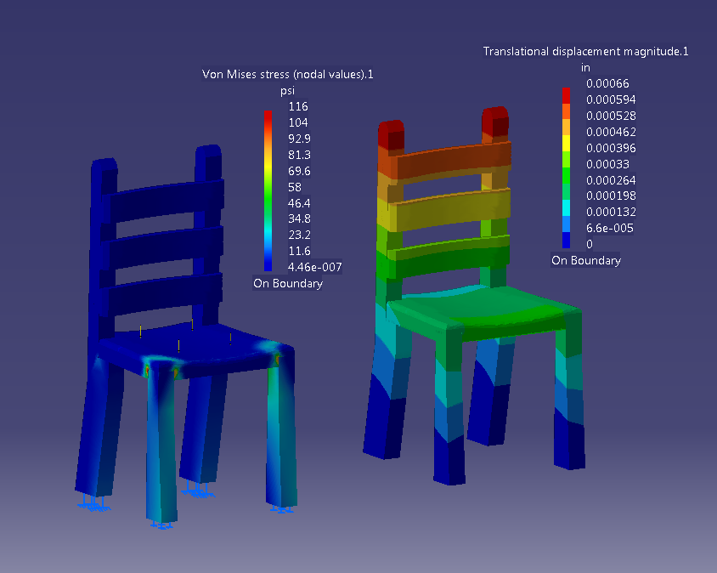
Why 3D Analysis?
- Large scale manufacturing companies use it but why should we?
- Smaller designers or personal use:
> Furniture
> DIY Projects
> More accurate simulations for animation
- Smaller scale designers or builders can save on materials and avoid more accidents with material analysis.
http://kevanelliscatiaportfolio.weebly.com/uploads/5/1/9/2/51924425/9995081_orig.png

Slide 5

State of the Art
- Finite element analysis the overwhelming technique used
> Companies like Autodesk, SimScale, etc.
- Finite Element Method:
> Computational model to approximate partial differential equations
> Discretizes a mesh into simple shapes, i.e. “elements”. Then numerically solves equations with said shapes.
- No major scale applications perform moment or balance analysis

Slide 6
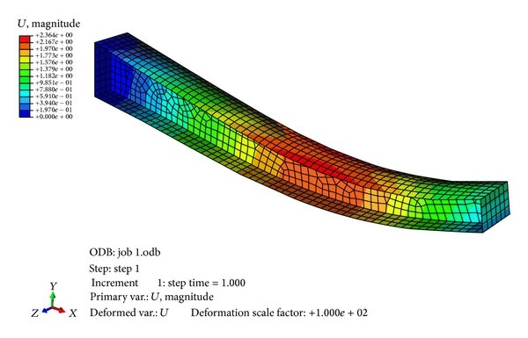
Finite Element Analysis Contd.
- How does finite element analysis work?
> Model split into finite elements
> Finite elements iterated over
> For each element Stiffness Matrix* found
> With some math from here we can then find displacement + forces applied
> This can be done with 1, 2 or 3 dimensional elements depending on our model
https://www.researchgate.net/publication/273180368/figure/fig5/AS:1088632035258371@1636561511281/Finite-element-model-of-tapered-beam.jpg
* Stiffness matrix represents a system of linear equations
to solve for our forces

Slide 7
Development Journey Challenges I faced and prototypes along the way
Prototype different FEM divisions
Sketching out how complex models can be separated into finite elements.
Finding best force application method
Considering most common force application methods:
- How wide of an area is a force going to be applied to - Which vertices are affected by a force application
Prototyping object representation
Manually making crystalline lattices? – Testing in Blender
Automatic crystalline lattices? – Sketching
Colour map to surface? – needs further ray casting
Ray casting? – would create irregular node spacing. Sketching + small low fidelity prototype
How do I represent final forces?
How do I generate the lattices?
No need for lattices if 3D finite elements are used.
Join to n closest nodes? – paper prototyping
Colour each face? – sketch + experiment with blender surfaces
Colour each edge? – easiest method but leaves interpretation to user

Slide 8
Current Methodology
1) Model read in from Blender
2) Model reduced to vertices, edges and faces
2)a) If multiple models exist they are linked together to form one cohesive mesh
3) Nodes each have forces applied to them
4) Each edge is treated as a 1 dimensional finite element (like a thin bar would be)
5) Analysis is performed on the full system (element-wise)
6) Moment and balance analysis performed

Slide 9
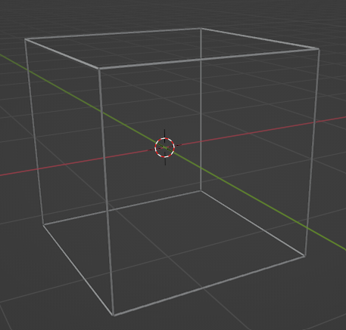
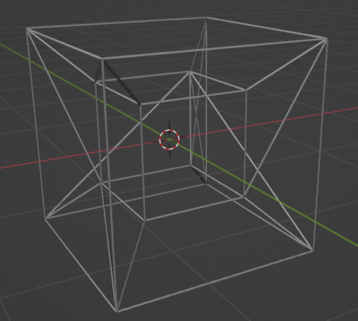
Demonstration
2) Model split into faces, edges + vertices
a) Linking multiple meshes from the n closest vertices
This helps approximate crystalline lattices in more complex objects

Slide 10
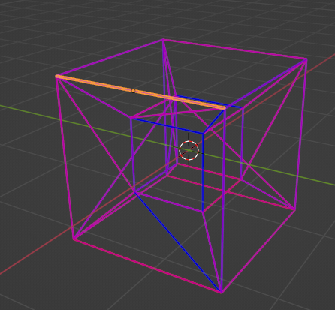
Demonstration
3) Random forces applied to each node
4) Edges each treated as a 1-dimensional finite element
Impossible to represent 1 dimension so I add a small three-dimensional cylinder to represent each edge.

Slide 11
Chart

Slide 12
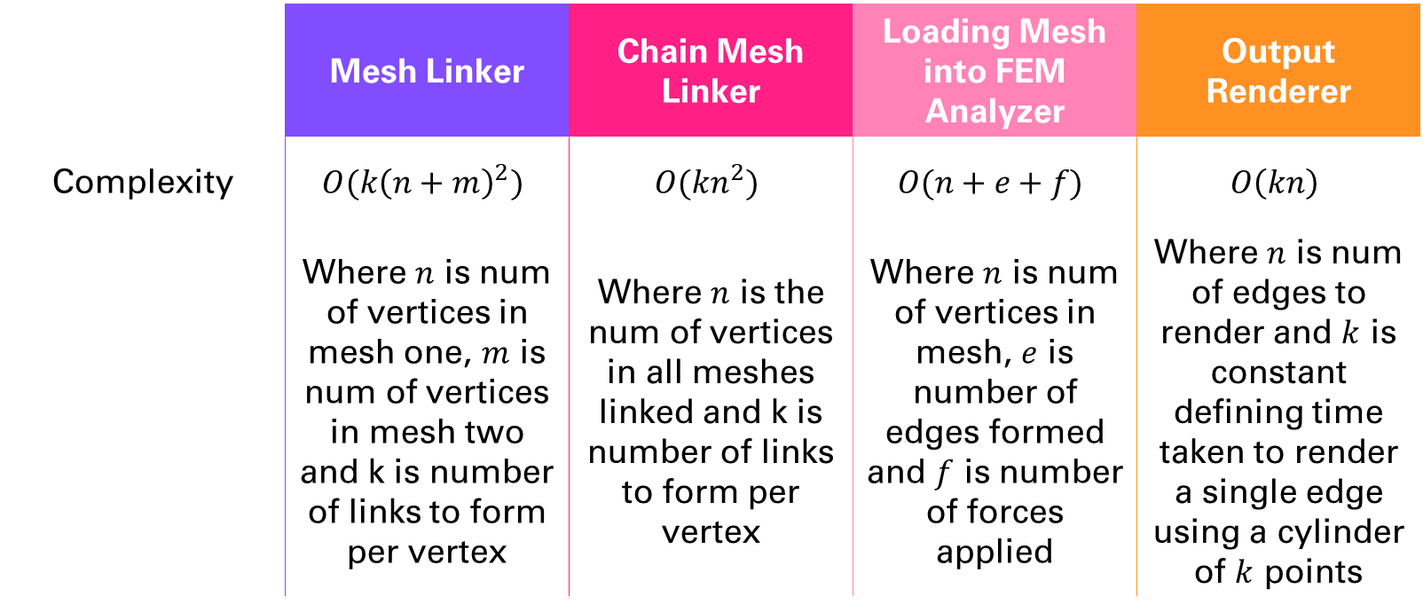
Algorithmic Complexities
 | Mesh Linker | Chain Mesh Linker | Loading Mesh into FEM Analyzer | Output Renderer
Complexity | $$O(k{\left(n+m\right)}^{2})$$ | $$O({kn}^{2})$$ | $$O(n+e+f)$$ | $$O\left(kn\right)$$
 | Where $n$ is num of vertices in mesh one, $m$ is num of vertices in mesh two and k is number of links to form per vertex | Where $n$ is the num of vertices in all meshes linked and k is number of links to form per vertex | Where $n$ is num of vertices in mesh, $e$ is number of edges formed and $f$ is number of forces applied | Where $n$ is num of edges to render and $k$ is constant defining time taken to render a single edge using a cylinder of $k$ points

Slide 13
Development Timeline
Integrate FEM
Integrate finite element analysis portion with current iteration
2D Finite Elements
Add support for two-dimensional finite elements.
Allows for more types of object to be accurately simulated
Materials + Saving
Add support for analysis of different materials
Adding support for saving objects
Balance Analysis
Allow for balance and moment analysis
Possibly allow for display of mesh deformation under imposed loads
Blender Integration
Integration of functionality into Blender’s menu system

Slide 14
Title
Subtitle
Subtitle
Add text, images, art, and videos.
Add transitions, animations, and motion.
Save to OneDrive, to get to your presentations from your computer, tablet, or phone.
Open the Design Ideas pane for instant slide makeovers.
When we have design ideas, we’ll show them to you right there.

Slide 15
Title
Subtitle
Subtitle
Subtitle
Add text, images, art, and videos.
Add transitions, animations, and motion.
Save to OneDrive, to get to your presentations from your computer, tablet, or phone.
Open the Design Ideas pane for instant slide makeovers.
When we have design ideas, we’ll show them to you right there.
This PowerPoint theme uses its own unique set of colors, fonts, and effects to create the overall look and feel of these slides.
PowerPoint has tons of themes to give your presentation just the right personality.

Slide 16



Summary
With PowerPoint, you can create presentations and share your work with others, wherever they are. Type the text you want here to get started. You can also add images, art, and videos on this template. Save to OneDrive and access your presentations from your computer, tablet, or phone.

Slide 17



Any Questions?
Gabriel Donnan
gd517@bath.ac.uk
https://github.com/gabedonnan/Blendiforce-SVA

